Slide 1

PROACTIVE DISASTER MANAGEMENT FOR FIRE HAZARDS

Slide 2

PIP2001 Capstone Project
Final Review
Viva-Voce
Batch Number:CIT-G31

Slide 3
Introduction
Fire incident is a disaster that can potentially cause the loss of life, property damage and permanent disability to the affected victim.
Major fire accidents do occur in industries like nuclear power plants, petroleum refineries, gas tanks, chemical factories and other large-scale fire industries resulting in quite serious consequences
With the advancement in the field of Robotics,IOT, human intervention firefighting robot comes in picture.

Slide 4
Literature Review
Title of the Paper
Fire extinguishing robot
Development of Fire Fighting Robot (QRob)
Automatic Fire Extinguisher Robot Using IoT
Automatic Fire Fighting Robot
SOUND FIRE EXTINGUISHER ROBOT CONTROLLED BY SPEECH
AUTOMATIC IC FIRE EXTINGUISHER ROBOT
Development and Implementation of Arduino microcontroller-based Dual Mode Fire Extinguishing Robot
Autonomous Fire Detecting and Extinguishing Robot Hazards
FIRE FIGHTING ROBOT using IOT
An Analytical Study of Various Methods Used Autonomous FireExtinguishing RoboT

Slide 5
Research Gaps Identified
Despite significant advancements in fire hazard management, still exhibit notable research gaps that hinder their overall efficacy and scalability
. One critical gap lies in the integration of real-time data and predictive analytics for early detection and rapid response to fire outbreaks. Many current systems rely heavily on historical data and static risk models, which fail to account for dynamic variables such as sudden weather changes, human activities, and evolving land-use patterns. Additionally, while technological innovations like remote sensing, drones, and IoT-based sensors have shown promise in enhancing fire monitoring, their widespread implementation remains limited due to high costs, lack of infrastructure in remote areas, and insufficient interoperability between different platforms. Furthermore, there is a pressing need for more robust community engagement strategies, as many fire management programs overlook the importance of local knowledge and participation in hazard mitigation efforts.
Current approaches often emphasize top-down solutions, which may not adequately address the specific vulnerabilities and resilience capacities of local communities, particularly in marginalized or rural regions. Another significant research gap involves the development of comprehensive multi-hazard risk assessment frameworks that consider the cascading effects of fire hazards on other critical infrastructure, ecosystems, and socio-economic systems.
Most existing models tend to focus narrowly on fire suppression and immediate containment, neglecting the long-term impacts on environmental sustainability, public health, and economic recovery. Lastly, regulatory and policy frameworks for fire management are often outdated and fail to keep pace with emerging risks driven by climate change, urbanization, and deforestation, highlighting the urgent need for adaptive governance mechanisms that can facilitate more flexible, data-driven, and context-specific interventions. Addressing these gaps through interdisciplinary research, technological innovation, and inclusive policy-making is essential to building resilient communities and ecosystems capable of withstanding the increasing frequency and severity of fire-related disasters.

Slide 6
Proposed Method
The proposed methodology for a fire extinguishing robot using Arduino Uno with GPS and GSM for alerts involves creating an autonomous robot capable of detecting and extinguishing fires in its surroundings while sending real-time notifications.
The robot will be powered by an Arduino Uno, which will serve as the central controller, interfacing with a flame sensor to detect the presence of fire. Upon detecting fire, the robot will activate a water pump or a servo-controlled nozzle to suppress the flames.
The robot's movement will be managed through an L298 motor driver, controlling DC motors that drive the robot's wheels, allowing it to navigate toward the fire
. The GPS module will provide the robot's location in terms of latitude and longitude, which is crucial for tracking and pinpointing the fire's location.
The GSM module will be responsible for sending SMS alerts to a predefined phone number, notifying emergency personnel or the user about the fire's occurrence and the robot's location.
Additionally, IR sensors can be integrated for obstacle avoidance, enabling the robot to navigate through complex environments safely. The robot will continuously monitor its environment for fire, move towards it, extinguish it, and send location-based alerts via SMS, ensuring prompt action and efficient firefighting.
This methodology combines automation, safety, and real-time communication, providing a reliable solution for fire detection and suppression.

Slide 7
Objectives
The goal of proactive fire hazard management is to minimize fire-related risks through preparedness, prevention, and mitigation.
This involves identifying vulnerabilities, using advanced tools for risk assessment and real-time monitoring, and enforcing safety regulations.
Key strategies include land-use planning to prevent wildfires, community education to promote readiness, and equipping firefighting teams for rapid response.
Collaboration among governments, NGOs, and communities is vital to building resilience, safeguarding lives and ecosystems, and reducing economic losses.
By leveraging technology and fostering cooperation, this approach aims to create safer, sustainable, and fire-resilient societies.

Slide 8
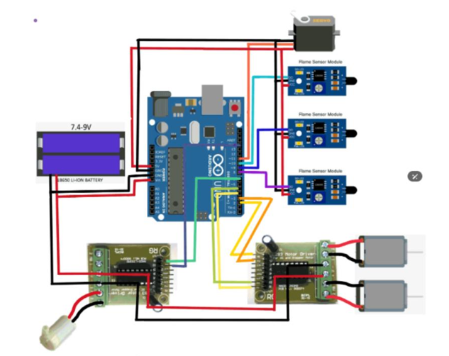
System Diagram and Implementation

Slide 9
* Power Supply: A 7.4-9V Li-ion battery provides the power for the entire system.
* Arduino Uno: This microcontroller acts as the brain of the robot, processing sensor data and controlling other components.
* Flame Sensors: Multiple flame sensors (three in this case) are connected to the Arduino. They detect the presence of fire.
* Motor Driver: This module controls the movement of the robot's motors.
* Motors: The motors are responsible for driving the robot.
* Servo Motor: This is likely used for steering or other robotic movements.

Slide 10
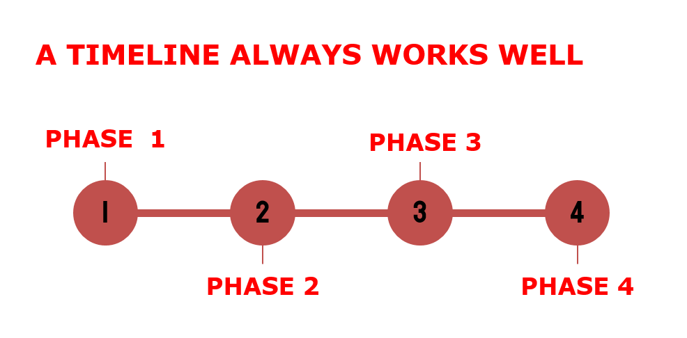
Timeline of Project

Slide 11

TIMELINE

Slide 12
Outcomes/Result Obtained
The fire extinguishing robot using Arduino Uno with GPS and GSM modules is an autonomous system for efficient fire detection and suppression.
Equipped with a flame sensor, motor driver, water pump, and obstacle avoidance, the robot can navigate complex environments to extinguish fires.
The GPS module provides real-time location tracking, while the GSM module sends instant alerts to emergency contacts with critical fire updates
. This system minimizes human intervention, speeds up response times, and enhances safety in industrial and residential settings, offering a reliable and automated solution to reduce fire risks and damages.

Slide 13
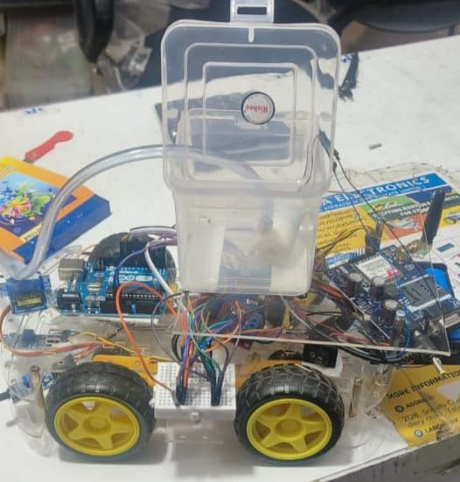
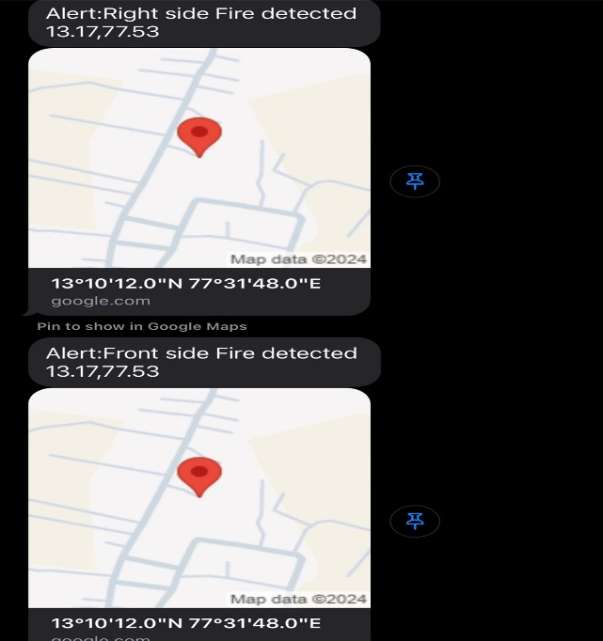

Slide 14
Conclusion
The fire extinguishing robot exemplifies the transformative potential of automation in fire safety. Its ability to detect, respond, and notify in real-time minimizes risks and enhances emergency coordination. By adopting innovative technologies like this, organizations can proactively address fire hazards, protect assets, and ensure safer environments for all.

Slide 15
References
1]. Che-Bin Liu and Narendra Ahuja, “Vision Based Fire Detection” International Conference on Pattern Recognition, pp.134 – 137, 2004.
[2]. I.Doshay, "Robotic fire protection system," U.S. PatentNo.6,364,026,April 2002
[3]. J. H. Hwang, S. Jun, S. H. Kim, D. Cha, K. Jeon and J. Lee, "Novel fire detection device for robotic fire-fighting "ICCAS 2010, Gyeonggido,2010, pp. 96-100.
[4]. K. L. Su, "Automatic Fire Detection System Using Adaptive Fusion Algorithm for Fire Fighting Robot," 2006 IEEE International Conference on Systems, Man and Cybernetics, Taipei, 2006, pp. 966-971

Slide 16
Publication Details

Slide 17
Thank You

